Slide 1


Ildar Ibiatov
08.09.2021

Slide 2

Outline
Executive Summary
Introduction
Methodology
Results
Conclusion
Appendix

Slide 3
Executive Summary
Summary of methodologies:
- Collecting the data (with SpaceX API and web scraping)
- Data wrangling
- Exploratory Data Analysis (EDA)
- Interactive Visual Analytics and Dashboard
- Predictive Analysis (Classification)
Summary of all results:
- The data was successfully collected and wrangled
- Classification models were able to achieve 83% accuracy.
- EDA and visual analytics showed the correlation between some features of the launches

Slide 4
Introduction
Project background and context: SpaceY is here to compete with SpaceX and show that Y much cooler than X!
Problems: we want to predict the success of SpaceX’s mission based on the launch features.

Slide 5


Slide 6
Methodology
Executive Summary
Data collection methodology:
Data was collected from SpaceX’s open API and Wikipedia (web scraping)
Perform data wrangling
Some statistics were calculated such as number of launches on each site and orbit
Additional columns added to facilitate the research such as Outcome
Perform exploratory data analysis (EDA) using visualization and SQL
Perform interactive visual analytics using Folium and Plotly Dash
Perform predictive analysis using classification models
Models showed 83% accuracy

Slide 7

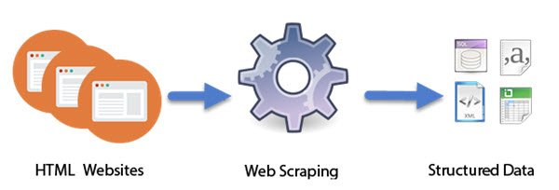
Data Collection
The data was collected via SpaceX’s open API and by web scraping Wikipedia.

Slide 8
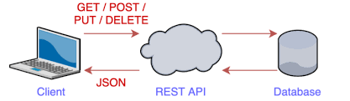
Data Collection – SpaceX API
The data as json is collected from the SpaceX’s REST API service. The it is converted and changed for our needs.
GitHub URL: https://github.com/CaptainSeaSoul/DataScienceCoursera/blob/0d00d49179661eecd9980ed48d8161e49027216e/Data%20Collection%20API%20Lab.ipynb
SpaceX

Slide 9
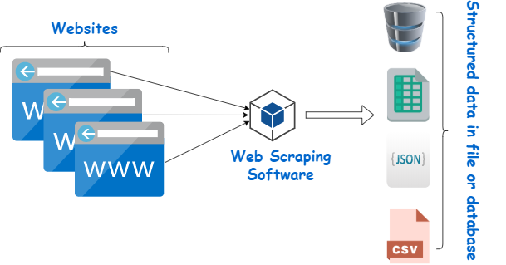
Data Collection - Scraping
By using BeautifulSoup I was able to collect data from Wikipedia’s tables on SpaceX’s launches. Later the data was turned into a dataframe and processed.
GitHub URL: https://github.com/CaptainSeaSoul/DataScienceCoursera/blob/7d281300960d51ef40544d6eb9fd3381507a4efd/Data%20Collection%20with%20Web%20Scraping%20lab.ipynb

Slide 10
Data Wrangling
After collecting the data, it needed to be processed. It had missing values and for the sake of convenience a few columns were added.
GitHub URL: https://github.com/CaptainSeaSoul/DataScienceCoursera/blob/9f722cca907bf517d079aa984a1e88a1e1e0ba0c/Data%20Wrangling%20Lab.ipynb

Slide 11
EDA with Data Visualization
The most important part was to show the correlation between the features and the mission outcome. So, we built scatter, bar and linear plot to find the dependency.
GitHub URL: https://github.com/CaptainSeaSoul/DataScienceCoursera/blob/19f02e426fb36f8b00c4d905341a146f65812aec/The%20EDA%20with%20Visualization%20lab.ipynb

Slide 12
EDA with SQL
Here are some sql queries that were performed:
The names of the unique launch sites in the space mission:
%sql select distinct(Launch_Site) from SPACEXDATASET
List the failed landing_outcomes in drone ship, their booster versions, and launch site names for in year 2015:
%sql select landing__outcome, booster_version, launch_site from SPACEXDATASET where landing__outcome = 'Failure (drone ship)' and YEAR(date) = 2015
GitHub URL: https://github.com/CaptainSeaSoul/DataScienceCoursera/blob/master/EDA%20with%20SQL%20lab.ipynb

Slide 13
Build an Interactive Map with Folium
In order to better understand the correlation between the launch site and the outcome we built an interactive map. The map shows the circles of the sites and the markers of the launches. Markers are green or red depending on the outcome.
GitHub URL: https://github.com/CaptainSeaSoul/DataScienceCoursera/blob/master/Interactive%20Visual%20Analytics%20with%20Folium%20lab.ipynb

Slide 14
Build a Dashboard with Plotly Dash
The interactive dashboard allows the user to choose the site and the payload to filter the graphs. The pie chart showed the success rate of the sites and the scatter plot showed the correlation between the payload and the outcome.
GitHub URL: https://github.com/CaptainSeaSoul/DataScienceCoursera/blob/8614262d21362a0ab837523d25a1d0355618702d/spacex_dash_app.py

Slide 15
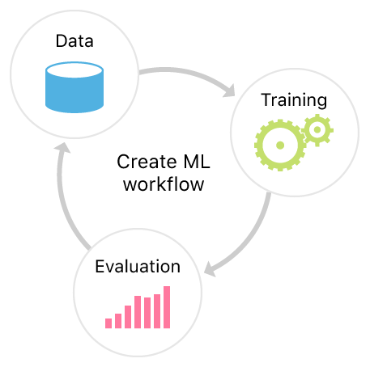
Predictive Analysis (Classification)
The data was scaled and then I simply scored the performance of 4 classification algorithms and found the best hyperparameters using GridSearchCV.
GitHub URL: https://github.com/CaptainSeaSoul/DataScienceCoursera/blob/master/Machine%20Learning%20Prediction%20lab.ipynb

Slide 16
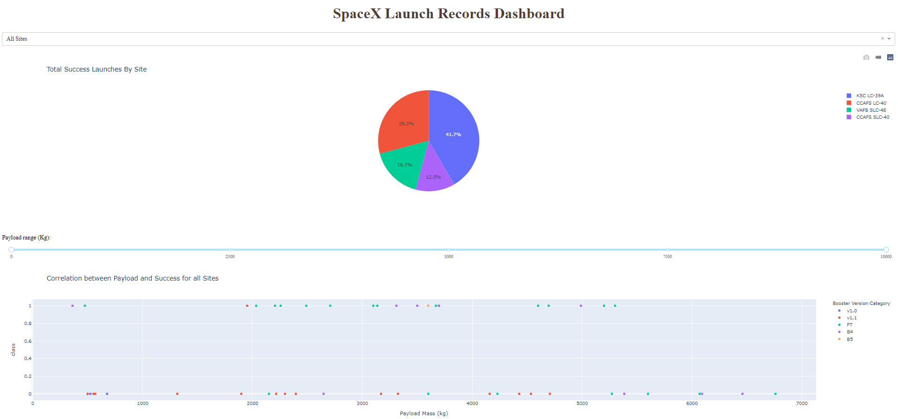
Results
Exploratory data analysis results:
We found that orbit, launch site, payload, and the number of flight correlates with the outcome
Interactive analytics demo in screenshots:
Predictive analysis results:
The models were able to achieve 83% accuracy.

Slide 17


Slide 18
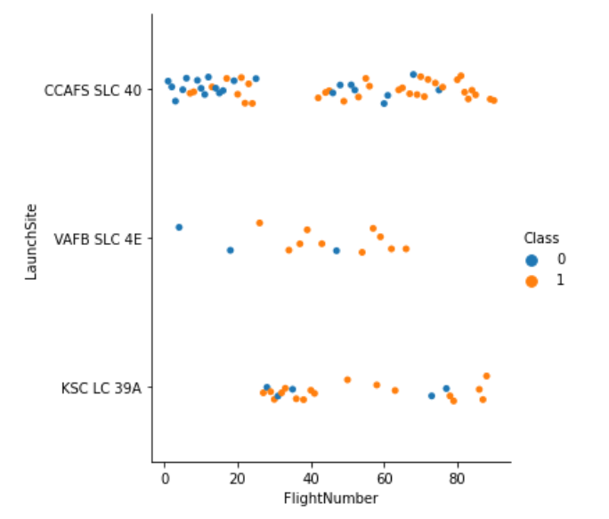
Flight Number vs. Launch Site
Plot FlightNumber vs LaunchSite. higher the flight number higher the success rate.

Slide 19
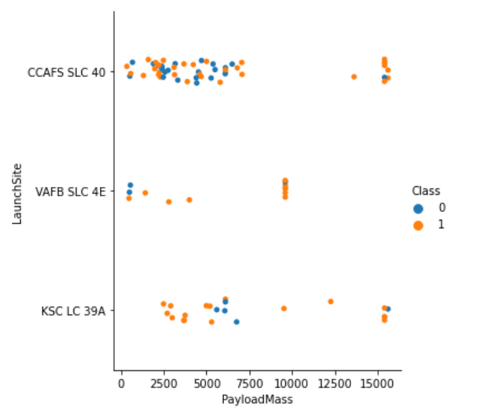
Payload vs. Launch Site
Scatter plot of Payload vs. Launch Site. I see no strict patterns. It's hard to say if the payload mass affects the class.

Slide 20
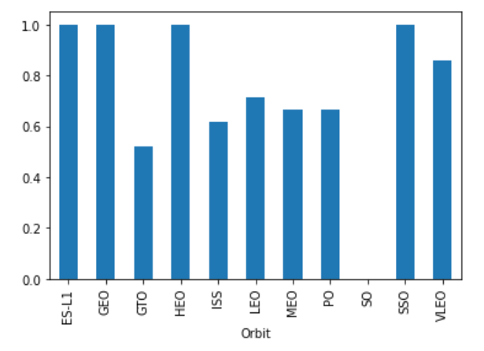
Success Rate vs. Orbit Type
Bar chart for the success rate of each orbit type.

Slide 21
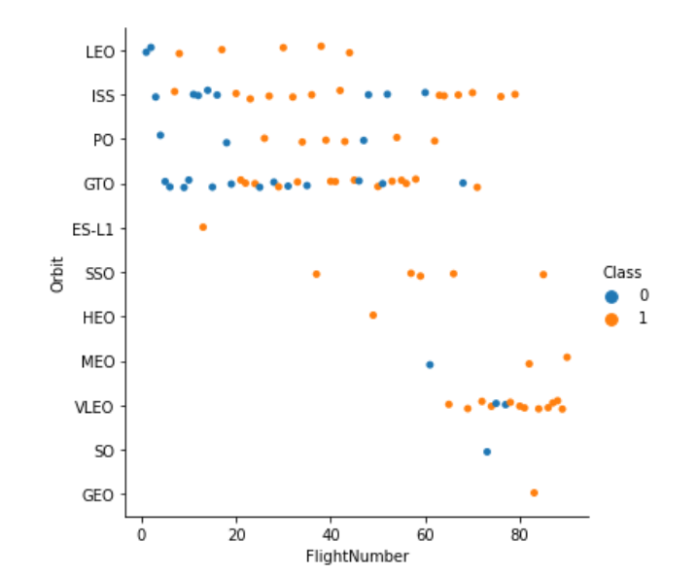
Flight Number vs. Orbit Type
Scatter point of Flight number vs. Orbit type. In the LEO orbit the Success appears related to the number of flights; on the other hand, there seems to be no relationship between flight number when in GTO orbit.

Slide 22
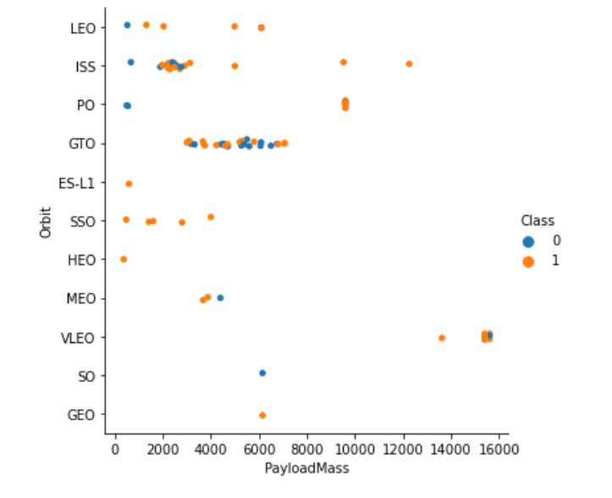
Payload vs. Orbit Type
Scatter point of payload vs. orbit type. Heavy payloads have a negative influence on GTO orbits and positive on LEO and Polar LEO (ISS) orbits.

Slide 23
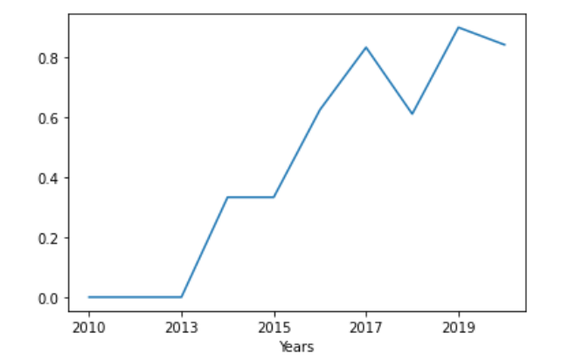
Launch Success Yearly Trend
Line chart of yearly average success rate. Where x axis is the extracted year and y axis is the success rate

Slide 24
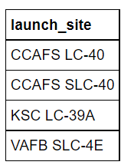
All Launch Site Names
A table with all the launch sites.

Slide 25
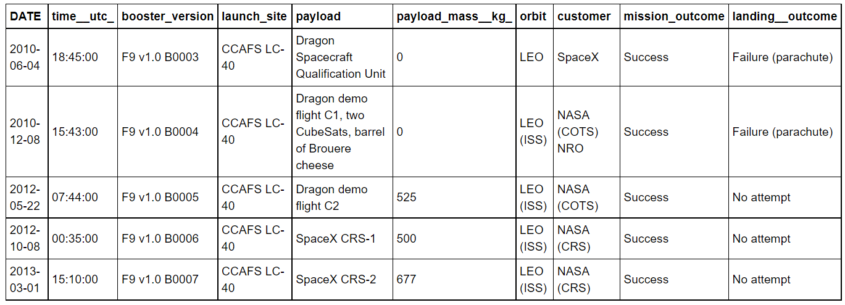
Launch Site Names Begin with 'CCA'
5 records where launch sites begin with `CCA`.

Slide 26
Total Payload Mass
Total payload carried by boosters from NASA: 45596 kg.

Slide 27
Average Payload Mass by F9 v1.1
The average payload mass carried by booster version F9 v1.1: 2534 kg.

Slide 28
First Successful Ground Landing Date
The dates of the first successful landing outcome on ground pad: 2015-12-22.

Slide 29
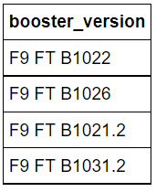
Successful Drone Ship Landing with Payload between 4000 and 6000
The names of boosters which have successfully landed on drone ship and had payload mass greater than 4000 but less than 6000.

Slide 30
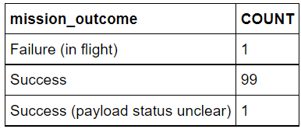
Total Number of Successful and Failure Mission Outcomes
The total number of successful and failure mission outcomes.

Slide 31
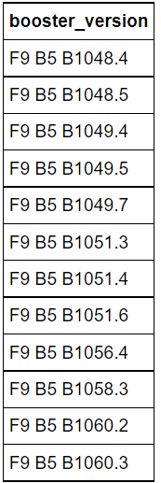
Boosters Carried Maximum Payload
The names of the booster which have carried the maximum payload mass.

Slide 32
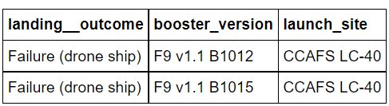
2015 Launch Records
The failed landing_outcomes in drone ship, their booster versions, and launch site names for in year 2015.

Slide 33
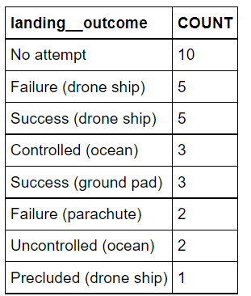
Rank Landing Outcomes Between 2010-06-04 and 2017-03-20
The count of landing outcomes (such as Failure (drone ship) or Success (ground pad)) between the date 2010-06-04 and 2017-03-20, in descending order

Slide 34


Slide 35
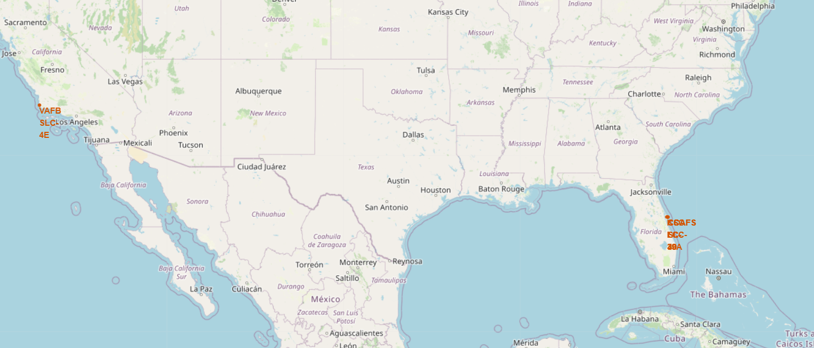
US Launch Sites
The map shows the launch sites. One is placed on the west and the rest on the east. All are next to a coastline.

Slide 36
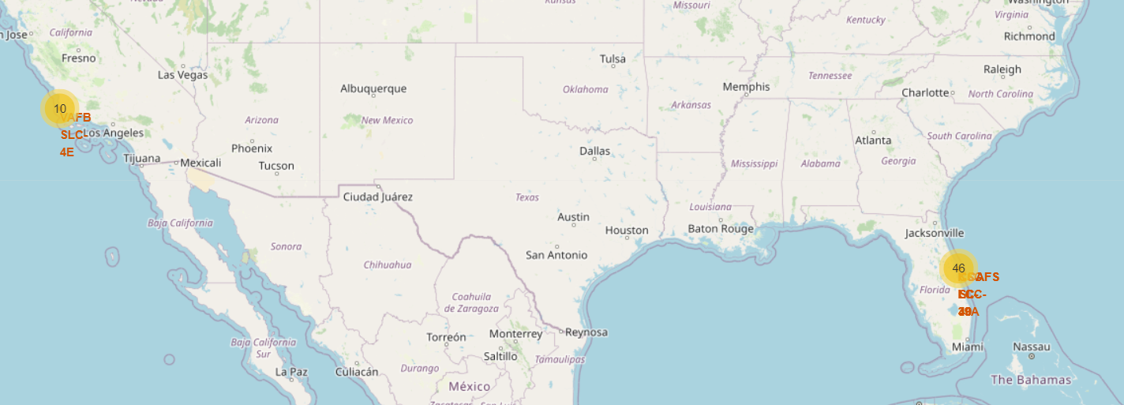
Number of Launches at the Sites
This map shows the amount of the launches performed at each launch site. The markers on the east are clustered so we sea there are 46 launches from 3 sites.

Slide 37
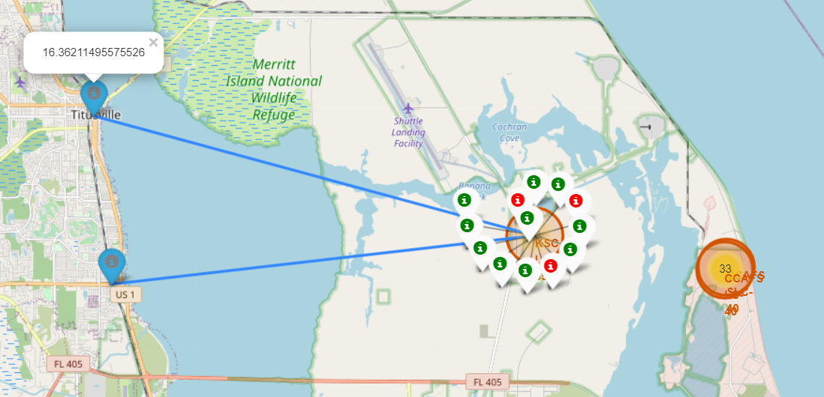
East sites attempts
The map shows more details about the eastern sites. It shows the distance to the closed railway and the town. It also uses colored markers to show launching attempts where green is success and red is failure.

Slide 38


Slide 39
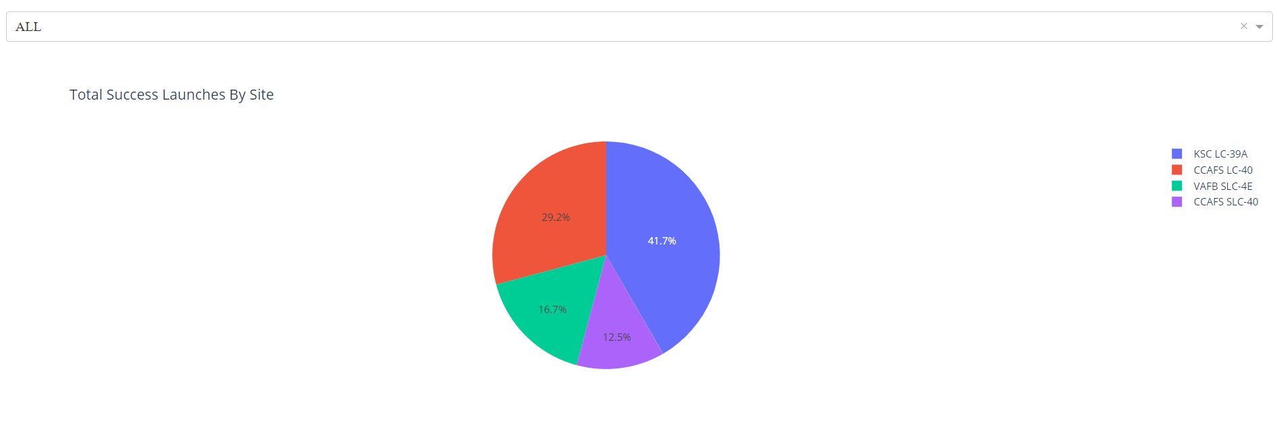
Total success launches by site
The pie chart shows total success launches ration by each site. We can see that CCAFS LC-40 has 29.2% success launches, KSC LC-39A has 41.7% - the most.

Slide 40
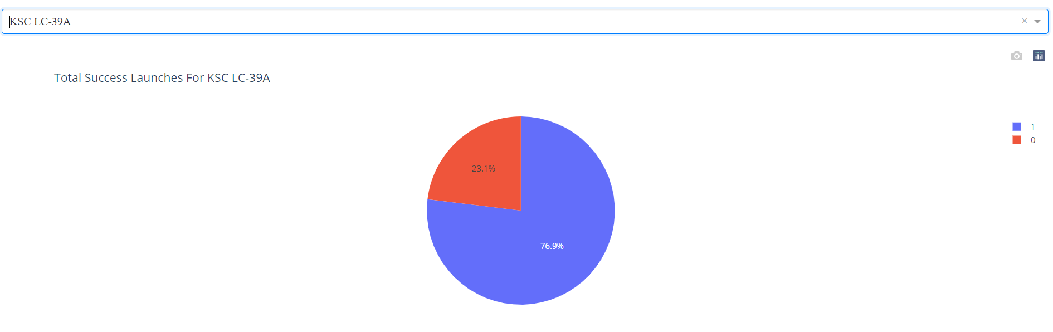
Piechart for the KSC LC-39A
The screenshot of the piechart for the launch site with highest launch success ratio.

Slide 41
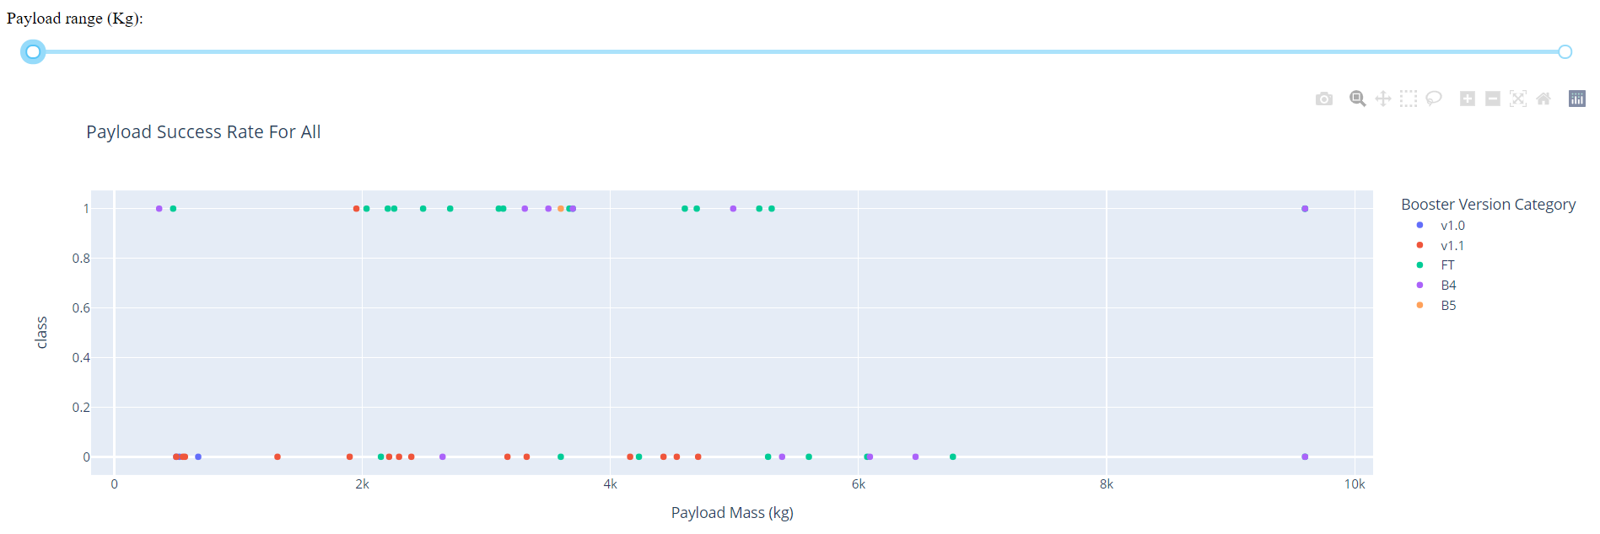
Payload Success Rate For All
Screenshot of Payload vs. Launch Outcome scatter plot for all sites. It is visible that FT booster has the largest success rate. V1.1 has the least. When payload is high the success rate diminishes.

Slide 42


Slide 43
Classification Accuracy

Slide 44
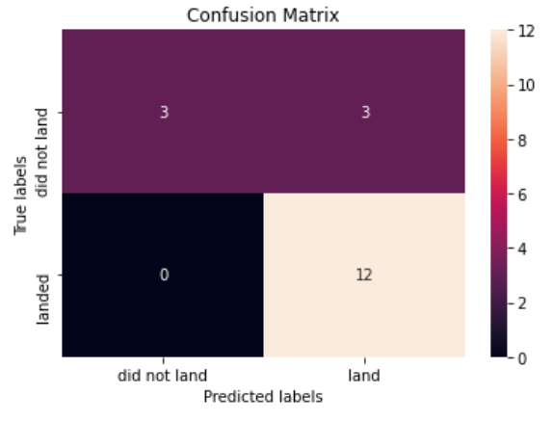
Confusion Matrix
All the models perform equally well on this dataset and produce the same confusion matrix.

Slide 45
Conclusions
Problem: we want to predict the success of SpaceX’s mission based on the launch features. The analysis of the data shows that we can predict the outcome of the mission based on the features such as payload mass, booster, launch site.
We created 4 models for classification and trained them on our data. Now it’s possible to predict the launch outcome with estimated accuracy of 83%.

Slide 46
Appendix
My repository with all the notebooks: https://github.com/CaptainSeaSoul/DataScienceCoursera
As a main platform I used IBM cloud where I ran all the notebooks (in IBM Watson). I stored data in DB2.
This presentation is my assignment for Applied Data Science Capstone course: https://www.coursera.org/learn/applied-data-science-capstone

Slide 47


